Slide 1
VM Stress Calculation
25th April 2018

Slide 2
Introduction
VM stress inputs
API RP 2RD Theory

Slide 3
Pipe Inputs
 |  | Units | Internal Pressure
Geometry
pipeNominalOD |  | m | 0.24765 | 0.24765
pipeNominalWT |  | m | 0.034925 | 0.034925
pipeMinimumWT |  | m | 0.034925 | 0.034925
pipeNominalID |  |  | 0.1778 | 0.1778
Material Properties
Yield Strength |  | ksi | 80
 |  | Pa | 5.52E+08
pipeA |  | m^2 | 0.023340213
pipeAi | Ai | m^2 | 0.024828666
pipeAo | Ao | m^2 | 0.04816888
pipeI | I | m^4 | 0.000135582
Loading
pipeExternalPressure | Po |  | 0
pipeInternalPressure | Pi | ksi | 0
pipeTensionEffective |  | N | 0
pipeMoment |  | Nm | -4.60E+05
PipeTrueTension |  |  | pipeTensionEffective + (pipeInternalPressure*pipeAi) - (pipeExternalPressure*pipeAo)
T |  |  | Pi*Ai

Slide 4

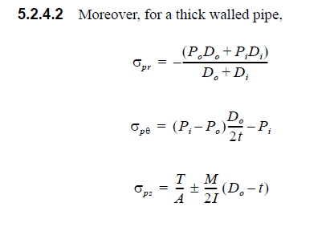
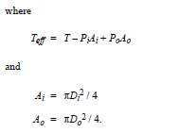
Theory
The vm stress is given below:
Each individual stress components are evaluated below

Slide 5
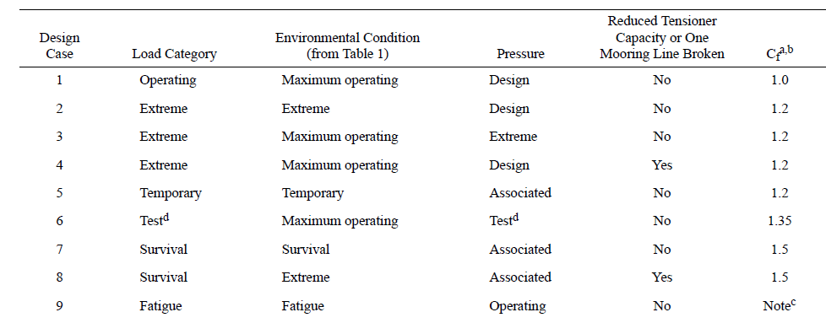
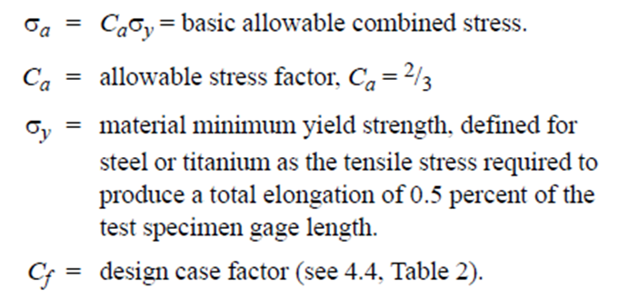
Theory

Slide 6
Way Forward
??

Slide 7
THANK YOU
For the opportunity to serve!

Slide 8
Document Revision History
01 | New Document | 28th June 2017 |  | VK
Rev | Description | Date |  | Author | Checked | Approved
Document No: |  |  | Client Ref:

